Slide 1
Securing your Infrastructure with Azure Sentinel
Subtitle or speaker name
Notes:
Welcome to Securing your Infrastructure with Azure Sentinel.
My name is [Speaker name].

Slide 2
Agenda
Azure Sentinel data
Analytics
Visualize
Security orchestration

Slide 3
Azure Sentinel data

Slide 4
Workspace considerations
Tenant
Single
Multiple
Data governance
Bandwidth costs

Slide 5


Workspace Design (Single Tenant) One single workspace per tenant – many customers can do this today!
Pros
Central pane of glass
Consolidates all security logs and information
Easier to query all information
Supported by all features of Azure Sentinel
Azure Log Analytics RBAC to control data access
Azure Sentinel RBAC for service RBAC
Cons
Data governance may drive limited scope
Can incur bandwidth cost cross region

Slide 6
Workspace Design (Single Tenant) Regional workspaces
Pros
No cross-region bandwidth cost
May be required to meet regulation requirements
Separate workspaces can add even more data control
Cons
No central pane of glass
Analytics, Workbooks, etc. must be deployed multiple times

Slide 7





Workspace Design (Single Tenant)
Tenant
Tenant
Subscription
Subscription
Resource Group
Resource Group Region A
Resource Group Region B
Workspace
Azure Sentinel
Workspace
Azure Sentinel
Workspace
Azure Sentinel

Slide 8
But what if I have multiple tenants?
Contoso |  |  |  |  | Northwind |  |  |  | Coho Winery
 |  |  |  |  | CENTRAL & SW | Prod. |  |  | Prod. | Staging | Test | Dev.
SALES, MKTG, & SERVICE |  | Prod. | QA | Dev. | EAST | Prod. |  |  | Prod. | Staging | Test | Dev.
LEGAL |  | Prod. | QA | Dev. | INCUBATION TEAM | Prod. |  |  | Prod. | Staging | Test | Dev.
HR |  | Prod. | QA | Dev. | NORTHWEST | Prod. | QA | Dev. | Prod. | Staging | Test | Dev.
Fabrikham |  |  |  |  | Proseware |  |  |  | Prod. | Staging | Test | Dev.
 |  |  |  |  |  |  |  |  | Prod. | Staging | Test | Dev.
VENDOR MGMT | Prod. | Training | Test | Dev. | VENDOR MGMT FOR REAL ESTATE | Prod. | Test/Dev. |  | Prod. | Staging | Test | Dev.
RETAIL | Prod. | Training | Test | Dev. | RETAIL | Prod. | Test/Dev. |  | Prod. | Staging | Test | Dev.
WEALTH MGMT | Prod. | Training | Test | Dev. | WEALTH MGMT | Prod. | Test/Dev. |  | Prod. | Staging | Test | Dev.

Slide 9
Workspace Design (Multi-Tenant) One workspace per tenant Use Azure Lighthouse to delegate access to the central tenant
BEST PRACTICE
Pros
Same as single workspace single tenant
Cons
No single pane across all tenants

Slide 10
Workspace Design (Multi-Tenant)
Optional, but not recommended
Ship logs from each tenant to a central tenant
Source → Event Hub → Logic App → Azure Log Analytics
https://docs.microsoft.com/azure/azure-monitor/platform/activity-log-collect-tenants
Incur costs for Event Hubs & Logic Apps
Data written via Logic App will be stored in a Custom Log (_CL)
Queries will have to be changed to support _CL

Slide 11
Workspace Design (Multi-Tenant)
Tenant A
Tenant B
Tenant C
Subscription
Subscription
Subscription
Resource Group
Resource Group
Resource Group
Workspace
Azure Sentinel
Workspace
Azure Sentinel
Workspace
Azure Sentinel
Azure Lighthouse

Slide 12



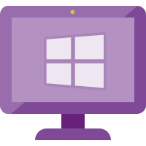



All the ways data gets in
Custom App
Appliances (Integrated)
Logic App – Send Data Connector
PUSH
Rest API
Threat Intelligence
(via Graph Security API)
MISP, Palo Alto….
Cloud Services
w/ Connector
O365, MCAS, AATP, MDATP, AWS
Workspace
Azure Sentinel
PULL
PUSH
Azure Services
(Diagnostic Logs)
AAD, AAD IP, Azure Activity, AIP, ASC, AzWAF, …
PUSH
Windows Agent
Linux Agent
Linux Agent – Configured for CEF
Appliances (CEF)
PUSH

Slide 13
Data Collectors (Quick Wins)
Enable 1st-party Connectors that are running in the environment
Most are free
O365
Azure Activity
1st Party Alerts – MCAS, AATP, MDATP, AAD IP
Connect AWS
Connect / Configure Azure Diagnostic Logs (Policy)
Deploy Windows/Linux Agent in Azure (built-in Policy)

Slide 14
Data Collectors (Next Steps)
Deploy Windows/Linux Agent
On-premises
Other clouds
Deploy CEF Collection
Configure CEF collector using configuration script
Configure source devices – ensure they support RFC and CEF
See the “Grand List” https://techcommunity.microsoft.com/t5/Azure-Sentinel/Azure-Sentinel-The-Syslog-and-CEF-source-configuration-grand/ba-p/803891
Integrate Threat Intelligence
Ask vendors to directly integrate!

Slide 15

CEF architecture
On prem
On prem
Syslog source
Syslog source
Syslog
Over UDP, TCP, or TLS default port: 514
Azure
Syslog source
Azure
Syslog source
Syslog agent
Syslog agent
Syslog source
Syslog daemon
(rsylog.d and syslog-ng)
Azure Sentinel agent
Azure Sentinel workspace
Syslog daemon
(rsylog.d and syslog-ng)
Azure Sentinel agent
Azure Sentinel workspace
Syslog source
UDP port: 25226
Restful API over TLS port: 443
UDP port 25226
Syslog source
Syslog source

Slide 16
CMK
Considerations….

Slide 17
Demo
Implementing customer managed keys for Azure Sentinel

Slide 18
Analytics

Slide 19

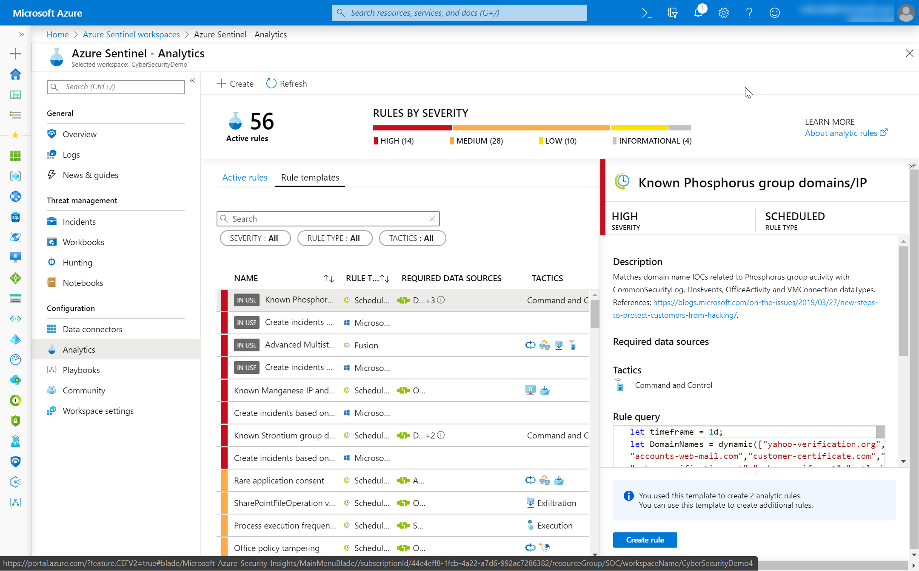
Analytics
You got data… now what? Create Analytics to detect suspicious activity
Enable Microsoft Security rules
Enable built-in rules
Use GitHub
Build custom detections

Slide 20
Built-in rules

Slide 21
Custom rules creation

Slide 22
Demo
Authoring custom rules

Slide 23
Alerts and automated threat response

Slide 24
Demo
API integrations with Microsoft Security Graph

Slide 25
Visualize

Slide 26
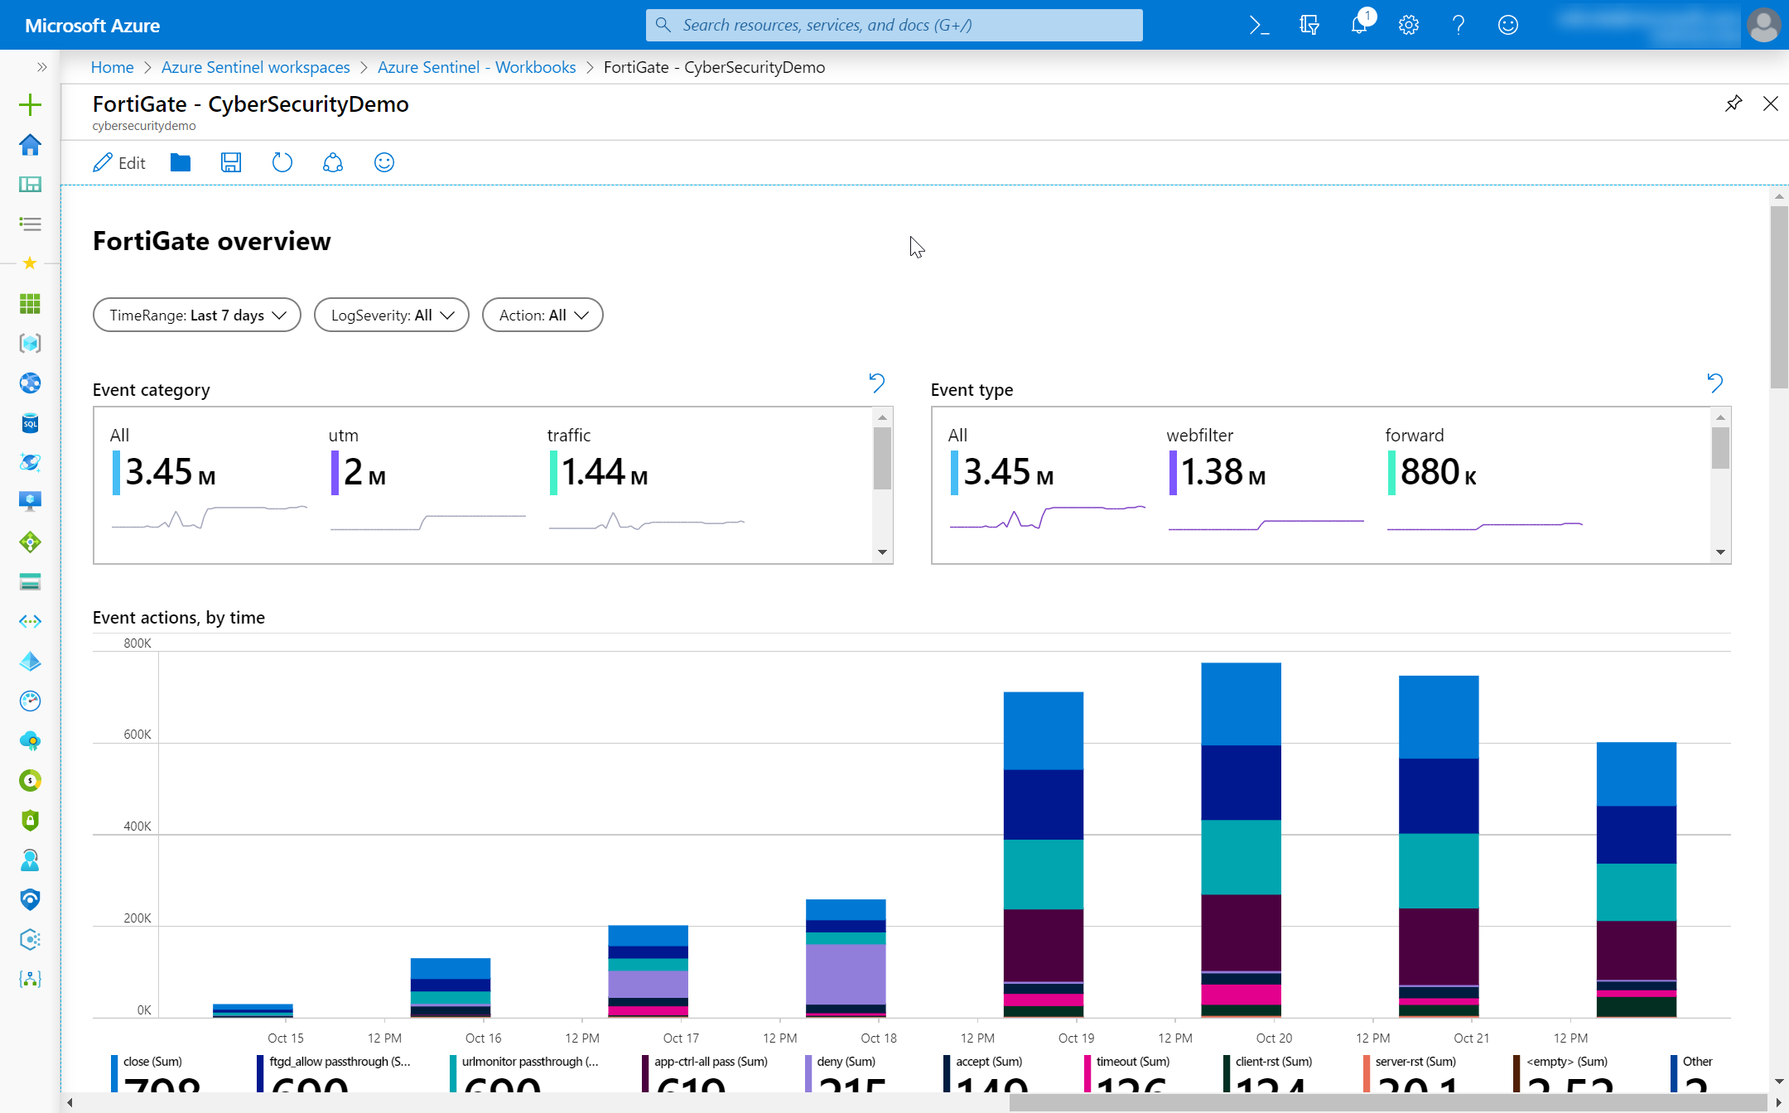
Data visualization
Monitor your data and activity
Use built-in workbooks
Use Power BI for external users

Slide 27
Create custom workbooks

Slide 28
Demo
Creating a custom workbook using Azure Monitor workbooks

Slide 29
Security orchtestration

Slide 30
Investigate
Investigate
Bookmark
Investigation graph

Slide 31
Demo
Investigation graph and bookmarks

Slide 32
Automated threat response
Create playbook
Run playbook

Slide 33
Demo
Automating incident response with playbooks

Slide 34
Thank you.
Notes:
Thanks for listening to Securing your Infrastructure with Azure Sentinel.
My name is [Speaker name].

Slide 35
Easy to modify 4 column table
Table header | Table header | Table header | Table header
To modify table, first click anywhere in table, so the Table Tools menu is highlighted at top | Layout > To add rows, click into cell and choose, Insert Above or Insert Below | Layout > Shrink or expand column widths by adjusting the Cell Size, or set them to same size with Distribute
To modify the table layout, click Table Tools > Layout To modify the table layout, click Table Tools > Design | Layout > To add rows, click into cell and choose, Insert Left or Insert Right | Layout > Use Alignment settings to adjust text alignment and cell margins | Tip: To quickly add a row, place cursor in this last cell and hit the Tab key

Slide 36
Additional table
 | Header 1 | Header 2 | Header 3 | Header 4 | Header 5 | Header 6
Row 1 | – | – | – | – | – | –
Row 2 | – | – | – | – | – | –
Row 3 | – | – | – | – | – | –
Row 4 | – | – | – | – | – | –

